Slide 1
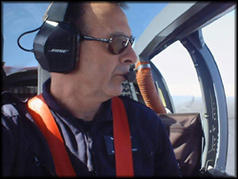
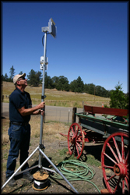
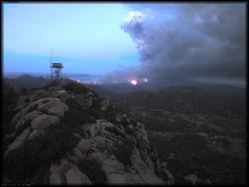
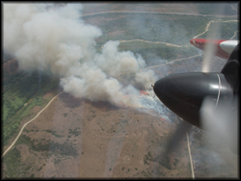
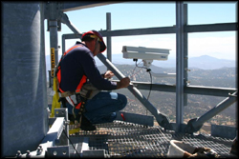
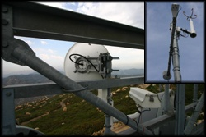
Evolution of California Firefighting
A reflection back on my career – from my earliest firefighting days to the recent highlights helping researchers with the NSF's funded High Performance Wireless Research and Education Network. Through development of digital links connecting, microwave antennas, cameras, incident command posts, firefighting facilities, and firefighters during major wildfire disasters. http://www.livescience.com/environment/070525_fire_fight.html

Slide 2
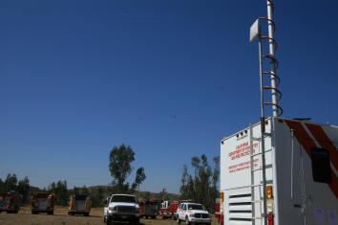
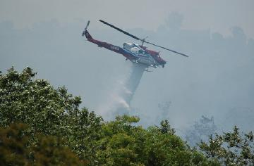
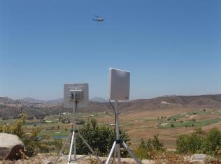
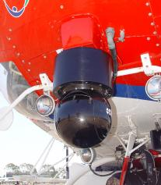
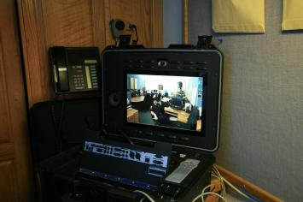
The 3Cs project and HPWREN demonstrated a multi-point video
conference using a SDFD firefighter helicopter with a real-time
video downlink during the 2007 Interagency Wildland Fire Drill

Slide 3
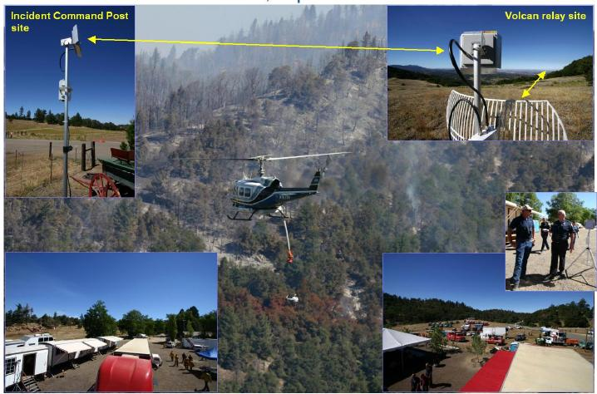
First Responder Survey of HPWREN Connectivity
Deployment for Incident Command Posts
Since 2003, the HPWREN project has been involved with public safety networking deployment, specifically in the context of creating data communications for Incident Command Posts, from where firefighting efforts for large wildland fires were managed. To understand first responder networking requirements, HPWREN staff administered a survey in the summer of 2006.

Slide 4
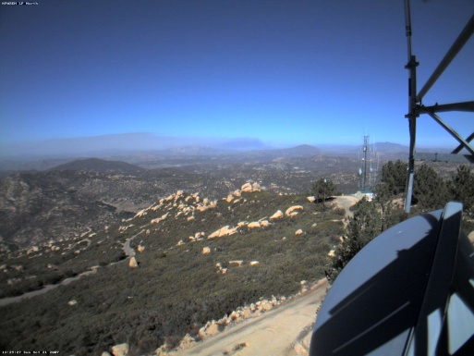
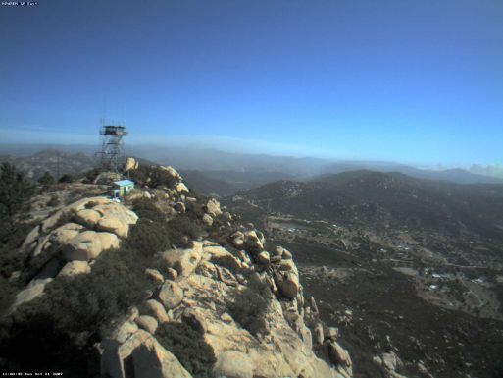
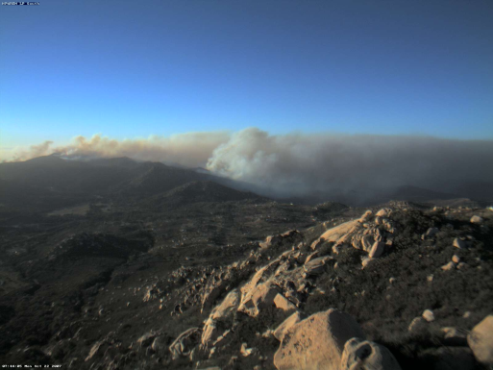
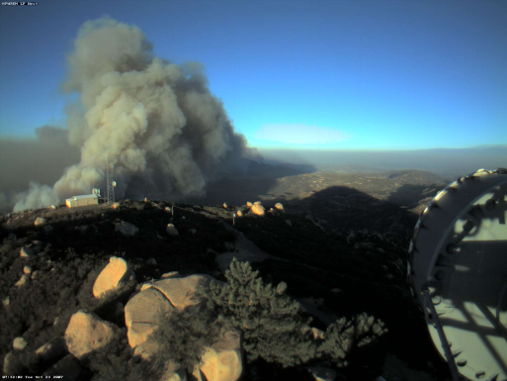
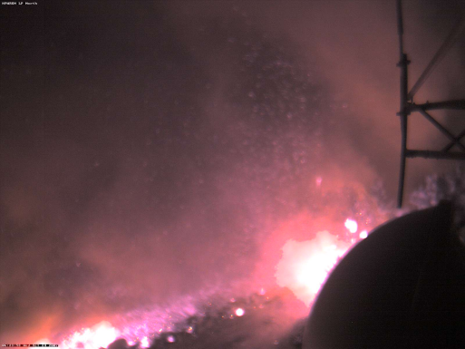
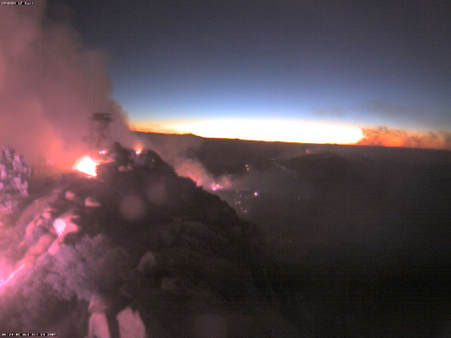
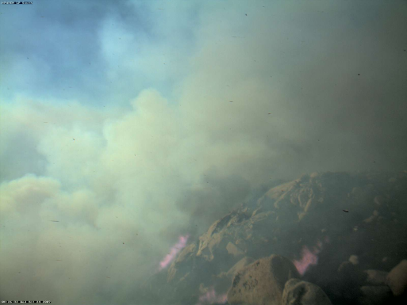
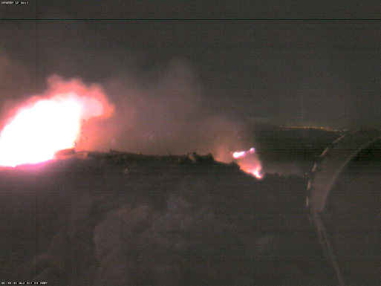
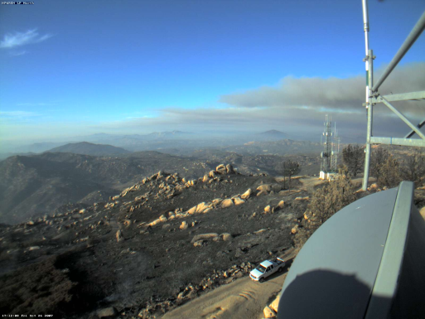
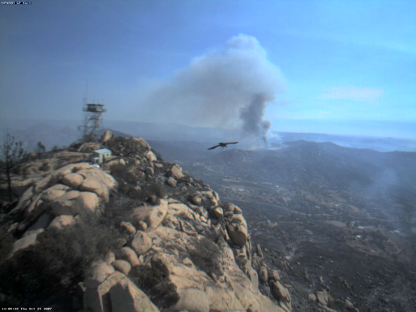
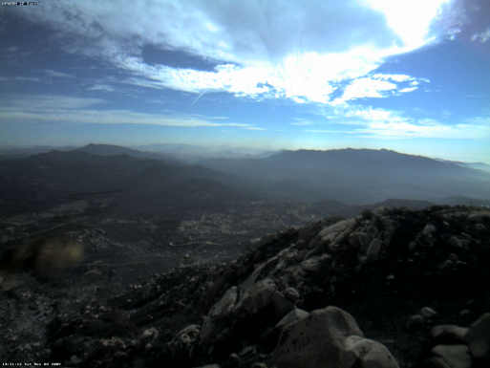
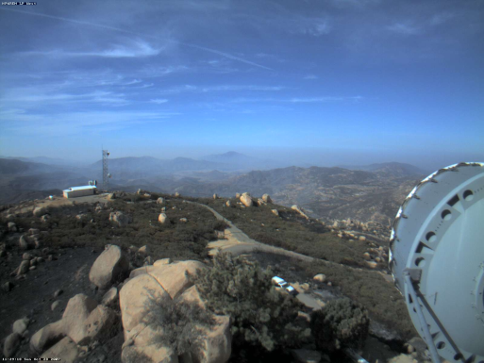
HPWREN cameras located on Lyons Peak utilized
during the October 2007 San Diego Fires
N E S W

Slide 5
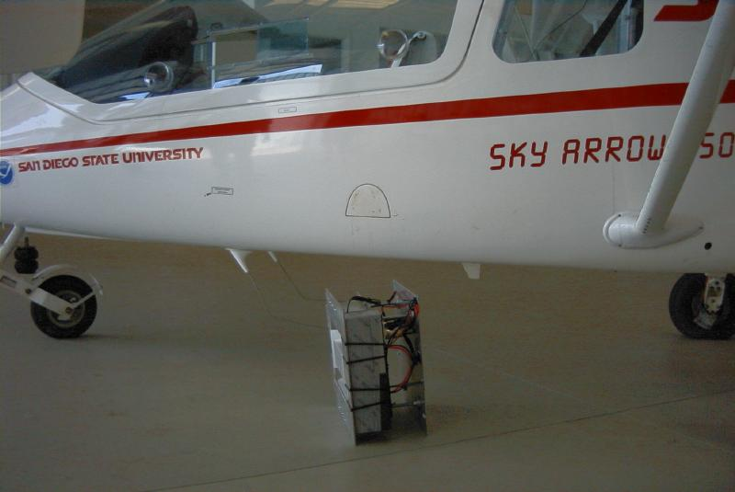
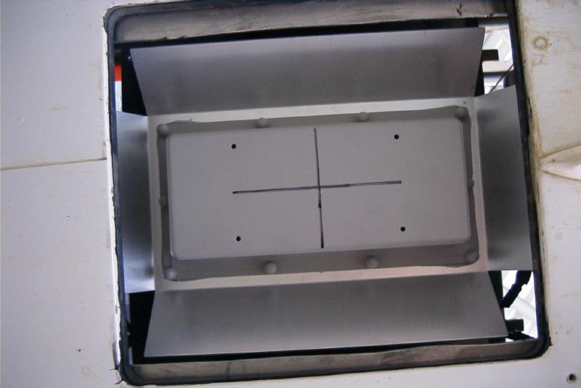
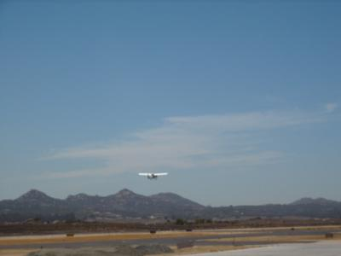
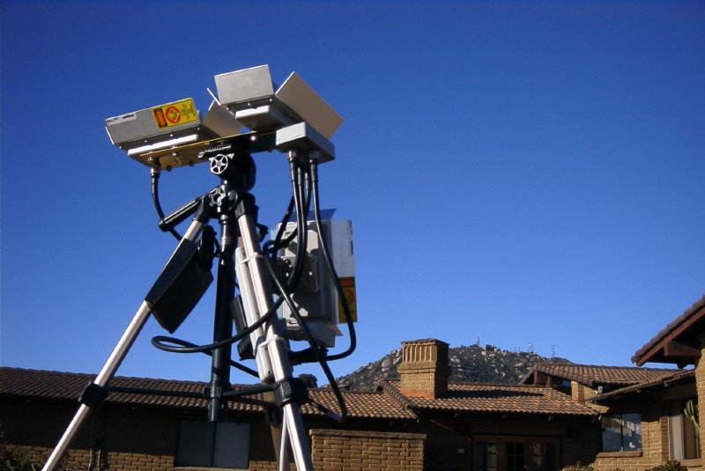
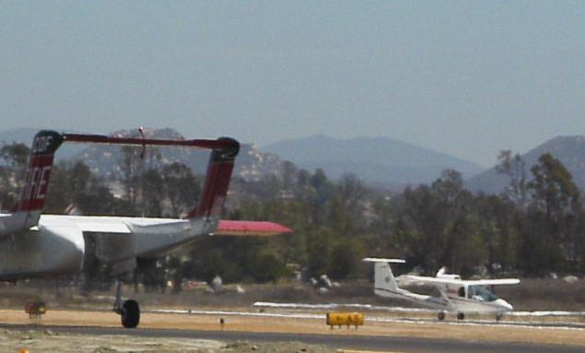
Flight communications test, fixed antenna - August 2002
backbone connection
ground station
local access

Slide 6
Situational Awareness for First Responders
First responders are hampered by a lack of real-time situational awareness when making critical decisions in response to rapidly changing conditions and life-threatening situations. In order to provide enhanced situational awareness for first responders on the ground, MIT Lincoln Laboratory has installed a camera system with real-time video downlink capability on AA-330, Cal Fire aircraft. This aircraft is being used for wildland fire reconnaissance, and to direct aerial operations during incidents. HPWREN has assisted MIT in a collaboration with this project.
The main features of the camera system and air-to-ground communication include:
Visible and IR video and still image capability streamed in real-time Image geo-
referencing and stabilization.
Geo-referenced camera pointing and fixed camera field of regard on a
stationary ground position.
Full-motion camera control in the air and later the by the ground personnel
http://hpwren.ucsd.edu/news/20090925/

Slide 7
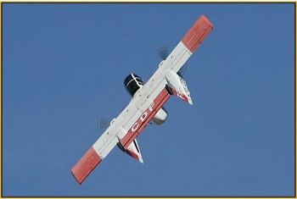
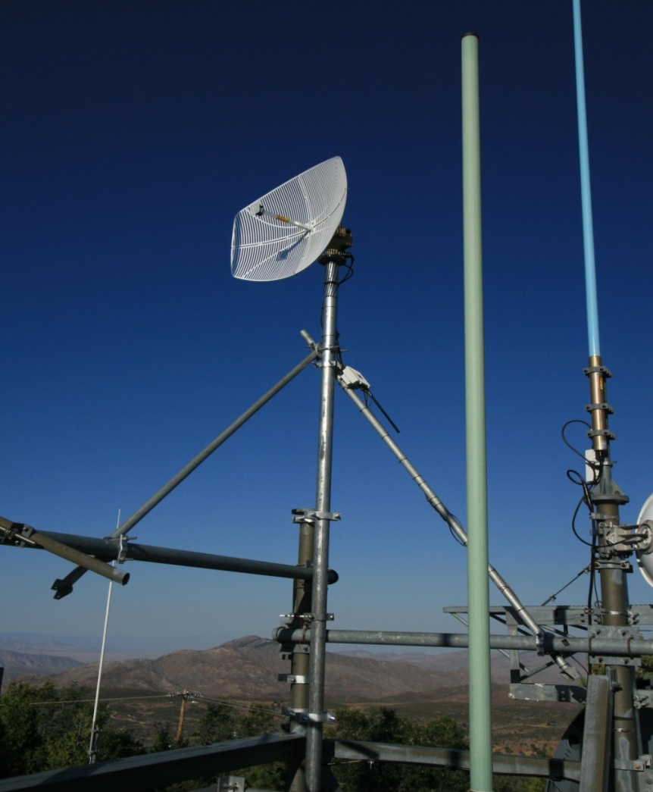
HPWREN provides the critical high-bandwidth aircraft data link between North Peak and the Internet. Live streaming full-motion video from the aircraft to points on the ground. HPWREN Team assisted in the installation and testing of the MIT equipment. A series of flight tests have been conducted the past few months examining the performance of the system during air-to-ground communication
Camera mounted on AA-330 Tracking antenna at North Peak

Slide 8
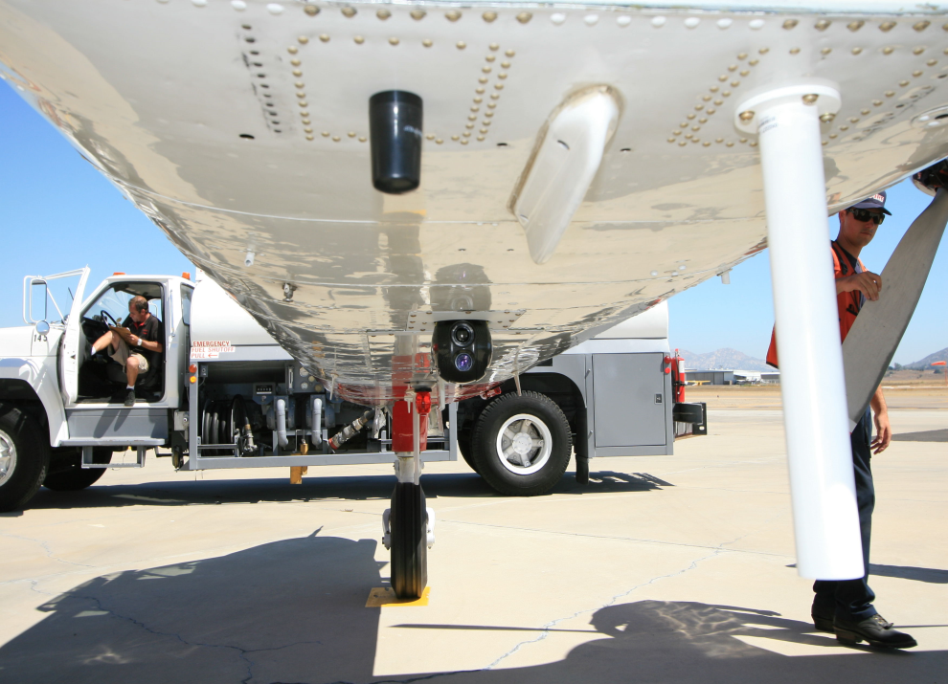
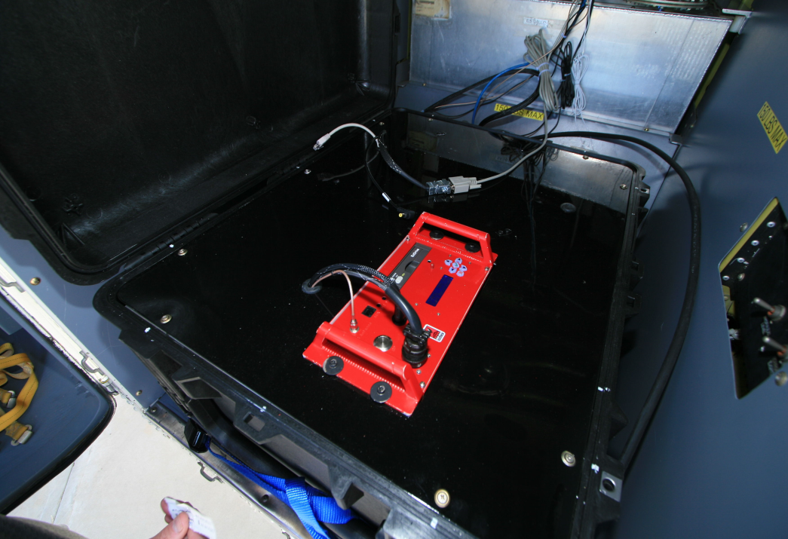
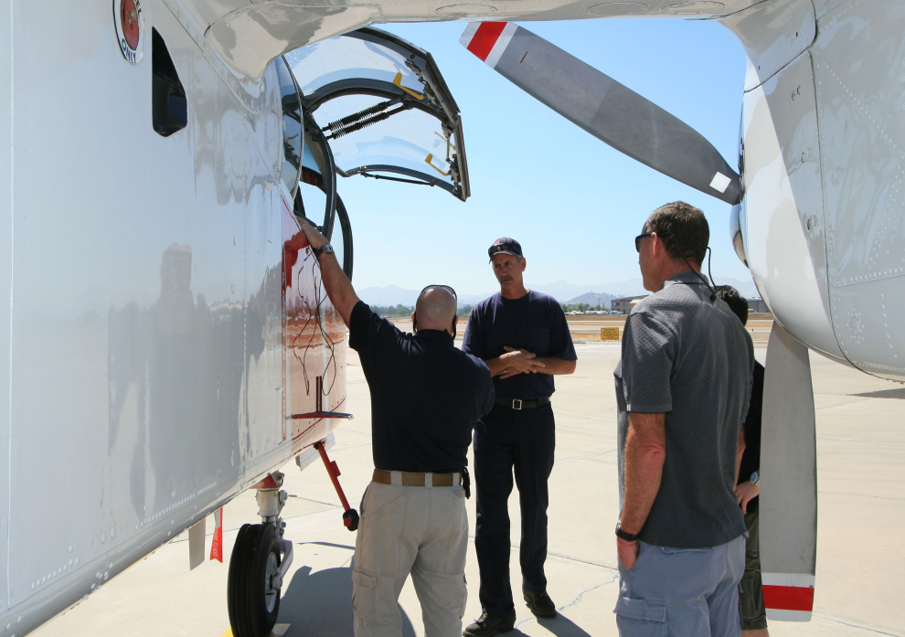
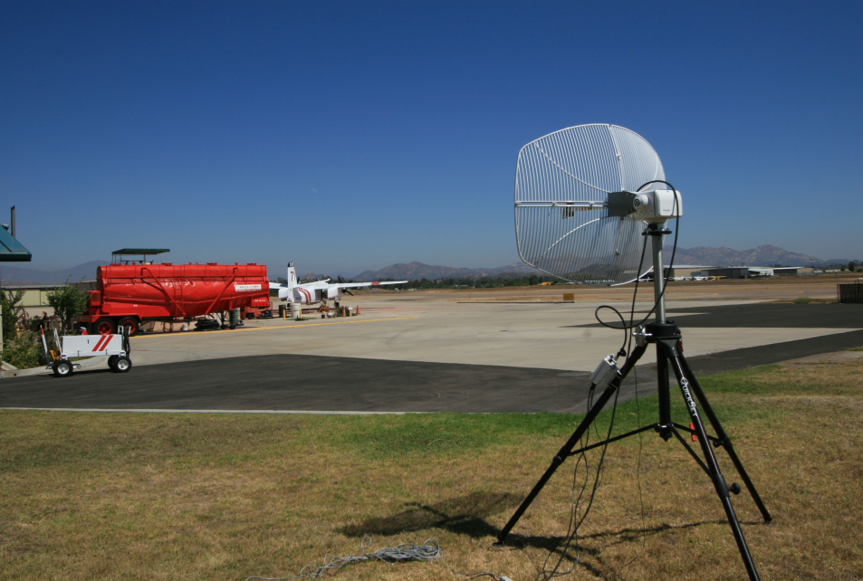
Camera & Antennas Radios w/DVR
Cockpit access w/ controls AAB w/Tracking antenna assembly

Slide 9
Questions
The End

Slide 10
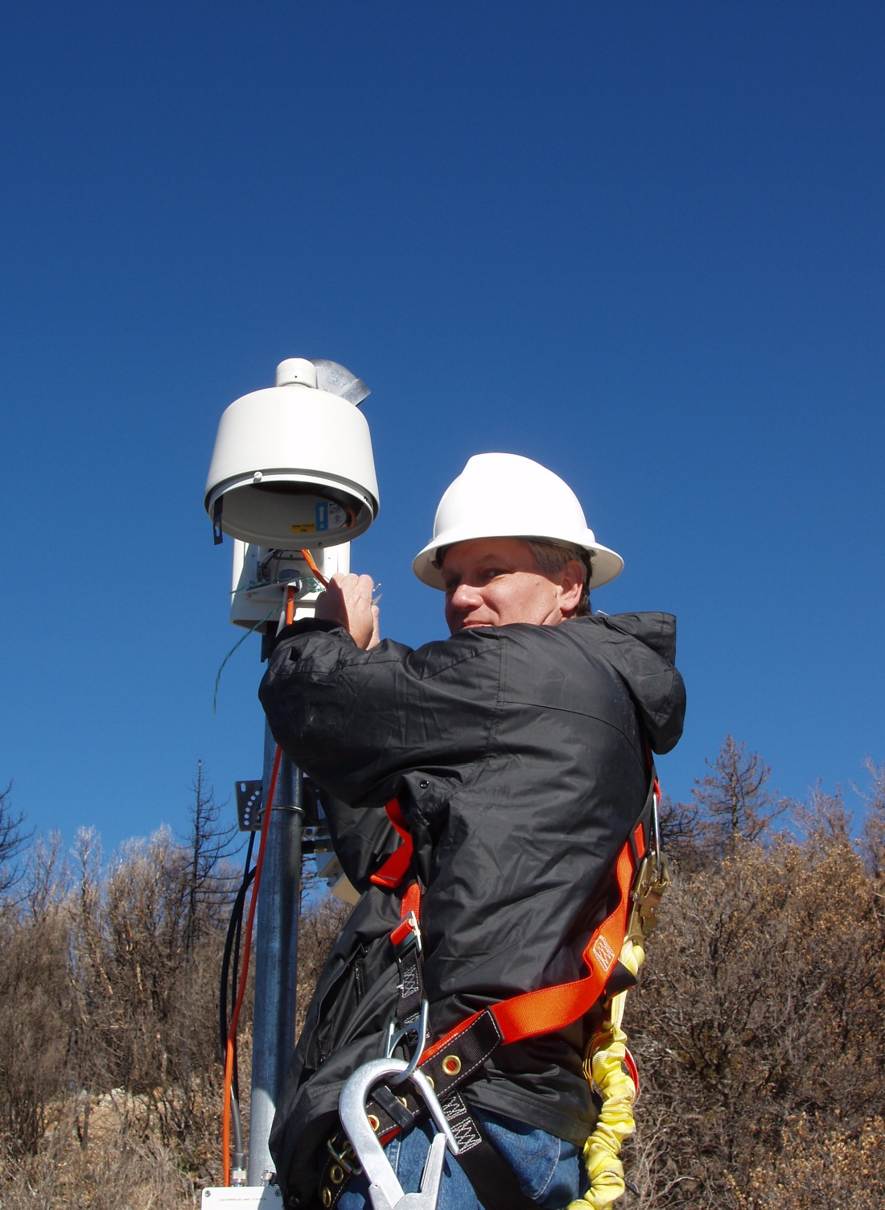
HPWREN and First Responders in 2009
This past year, fortunately there have not been any ICP deployments, even though the area remains under severe drought conditions for the seventh year. First responders especially the ECC dispatch centers rely heavily on the environmental cameras and sensors of HPWREN for daily weather conditions, reported fires and situational awareness in the county.
HPWREN continues to support many first responders in Cal Fire with reliable network connectivity and environmental alerts on a daily basis. Without this vital network, first responders would have to find other means of gathering information for situational awareness.
Personally I want to thank Hans Werner Braun and his dedicated associates for their hard work, research, dedication and persistence to maintain such a high level performance and reliability of HPWREN.
One man’s vision has lead to many great projects and collaborations, which would have never been possible without such passion and commitment.
Ron Serabia

