Slide 1
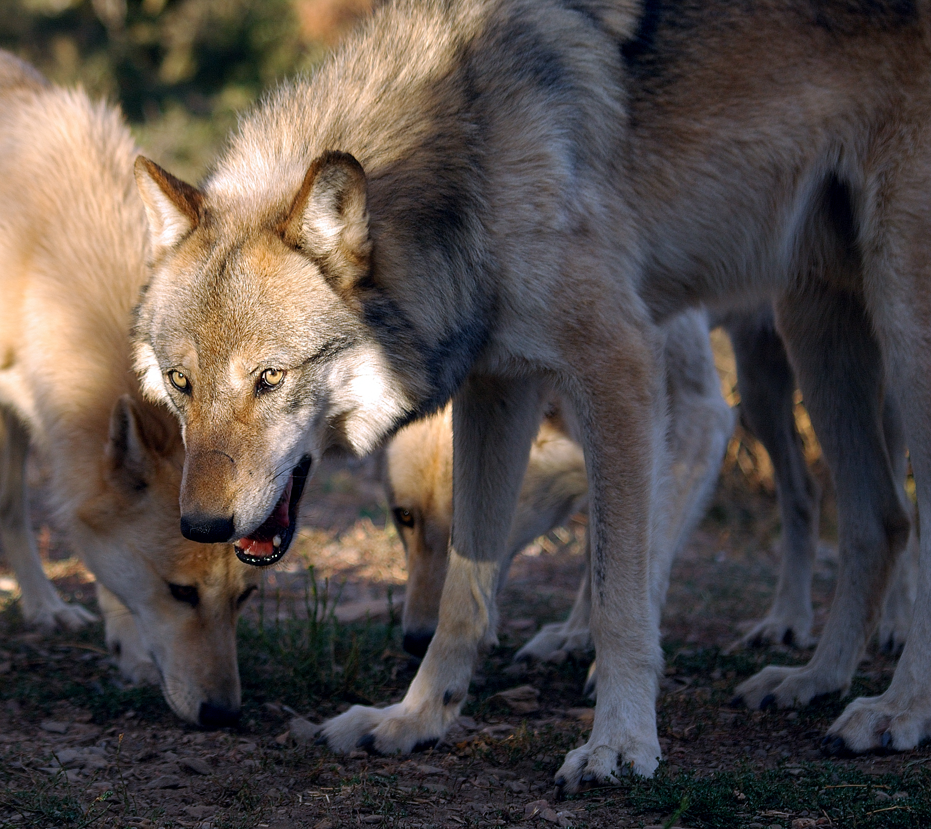
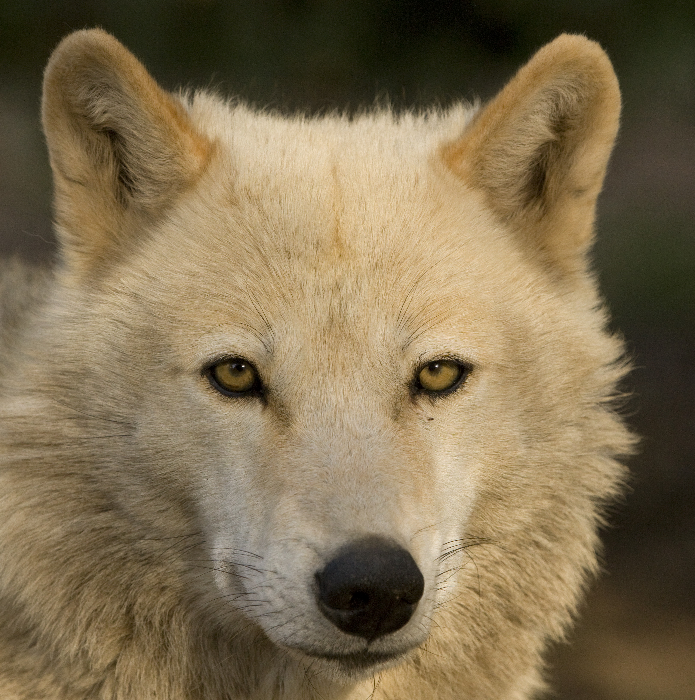
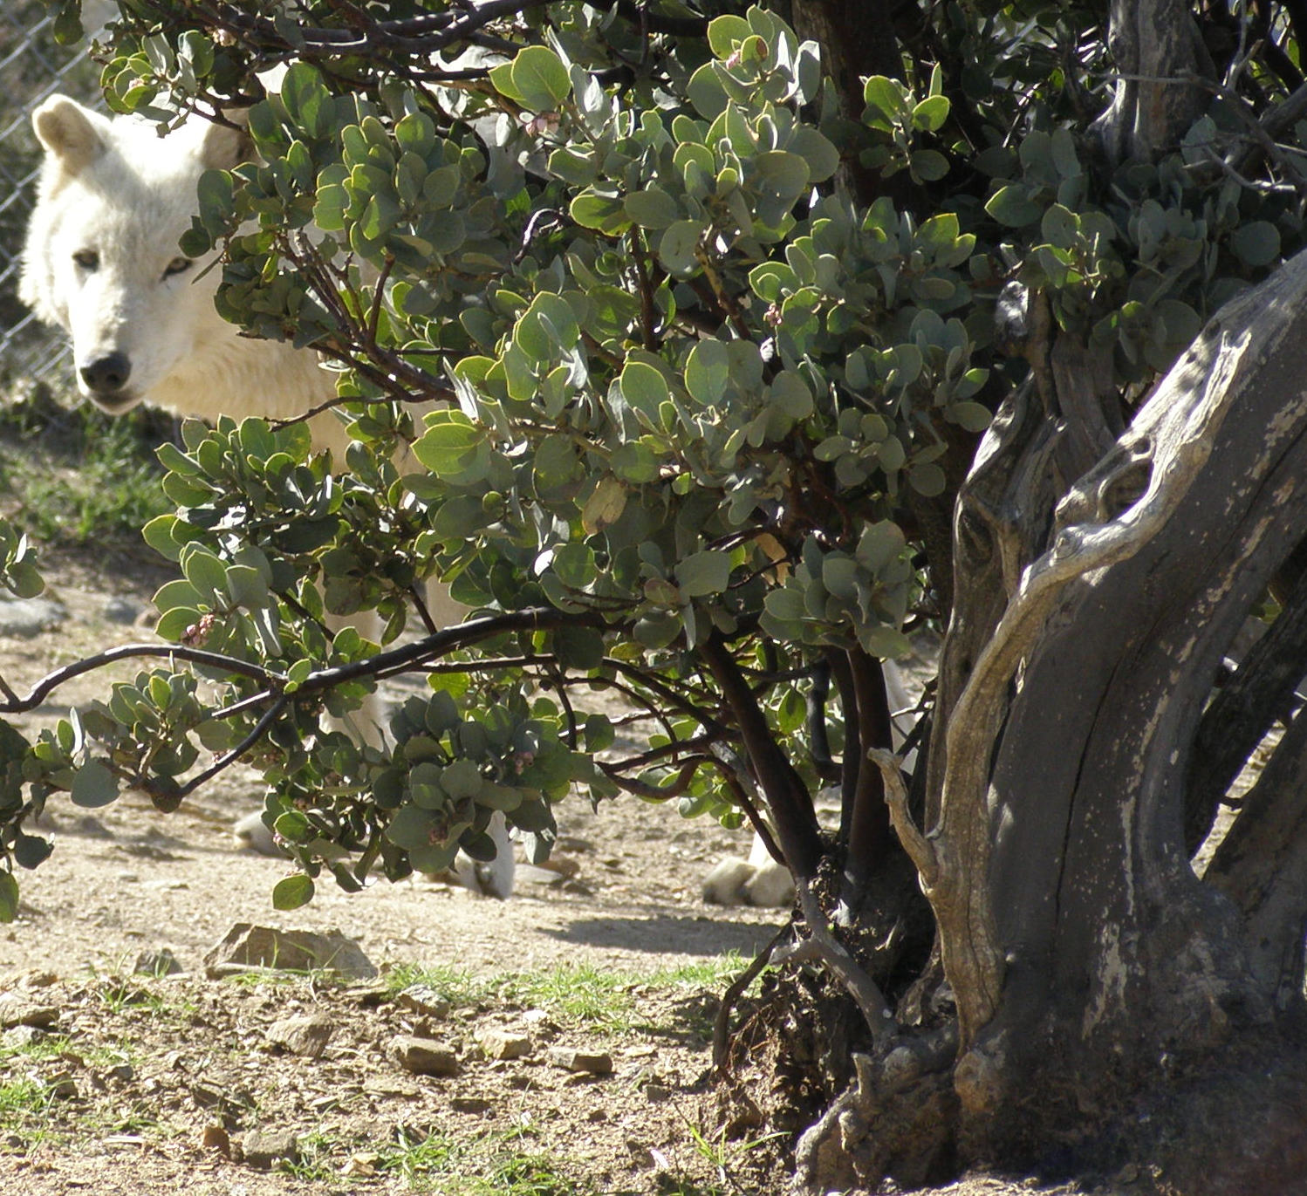
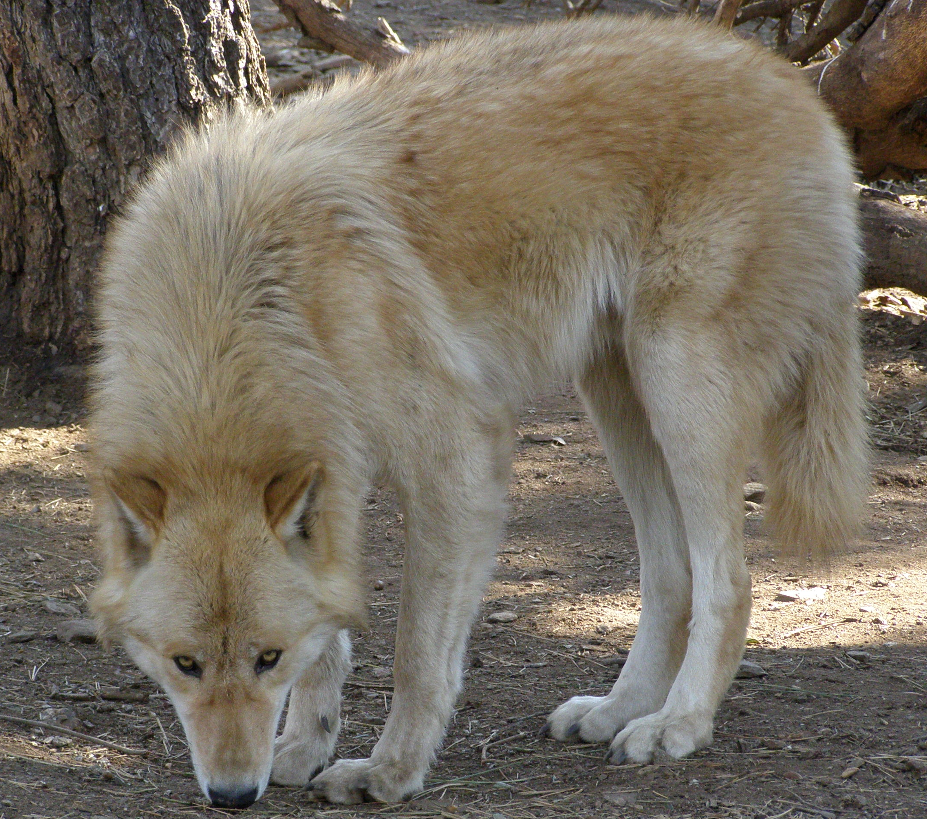
Education
Bi-directional interactive video and audio provide a unique learning experience and an opportunity for students to interact in real time with California Wolf Center educators; used in elementary, middle, and high schools, colleges and universities, libraries, museums, etc.
California Wolf Center internship offers students the opportunity to incorporate HPWREN technology into coursework or research
Distance learning programs continue to expand the use of HPWREN technologies
HPWREN at the California Wolf Center

Slide 2
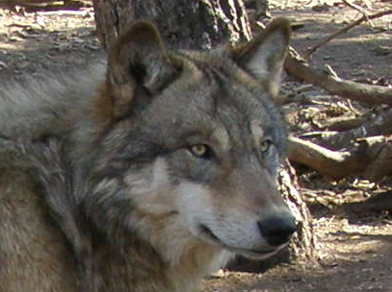
Public Access
Still photos, video, and audio from HPWREN cameras and acoustic sensors are available on the web for the benefit of both researchers and the public
Allows people to view and listen to the wolves when they are undisturbed by human presence; key to understanding wolves as they behave in nature because human presence affects wolf behavior
Provides access to those who cannot attend educational programs due to our remote location
HPWREN at the California Wolf Center

Slide 3
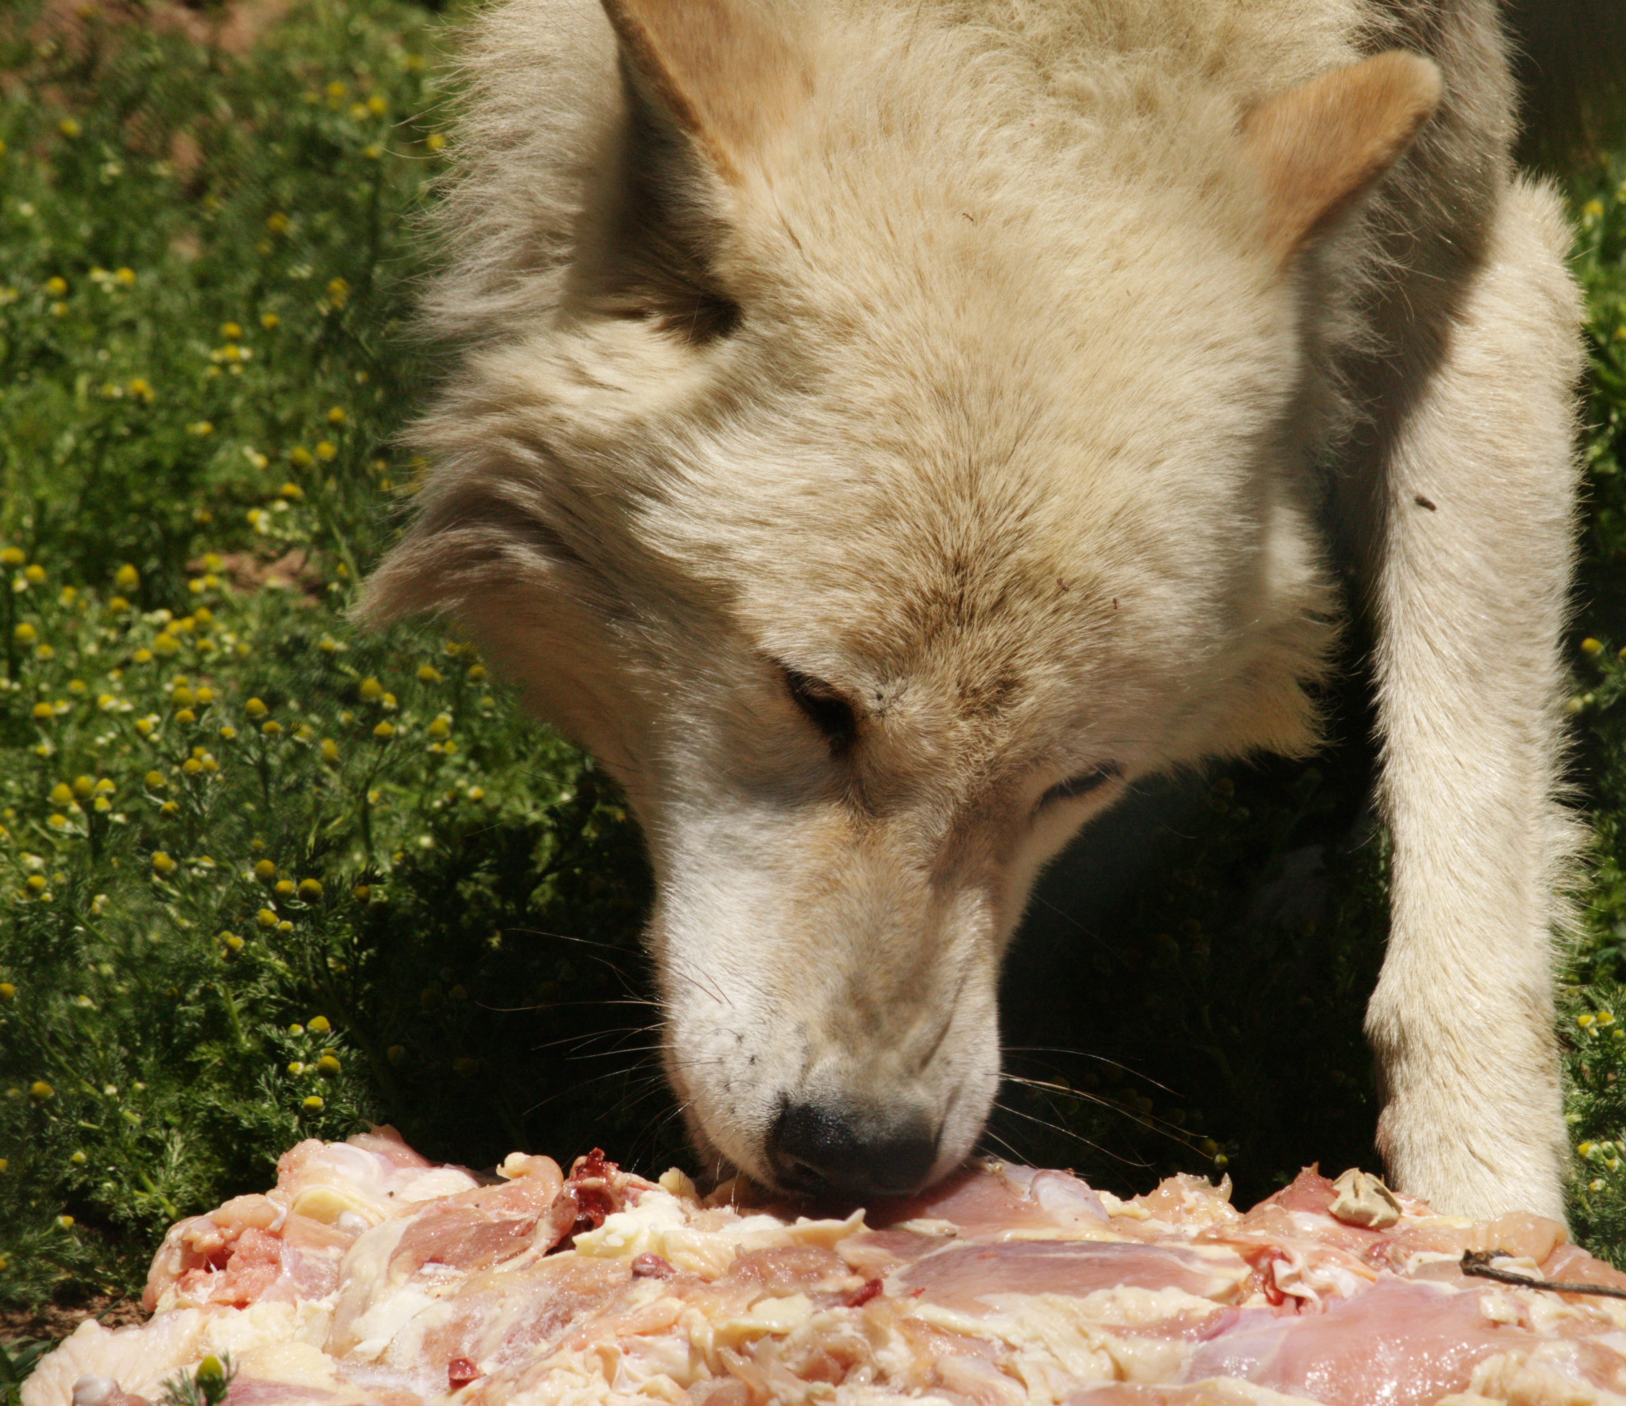
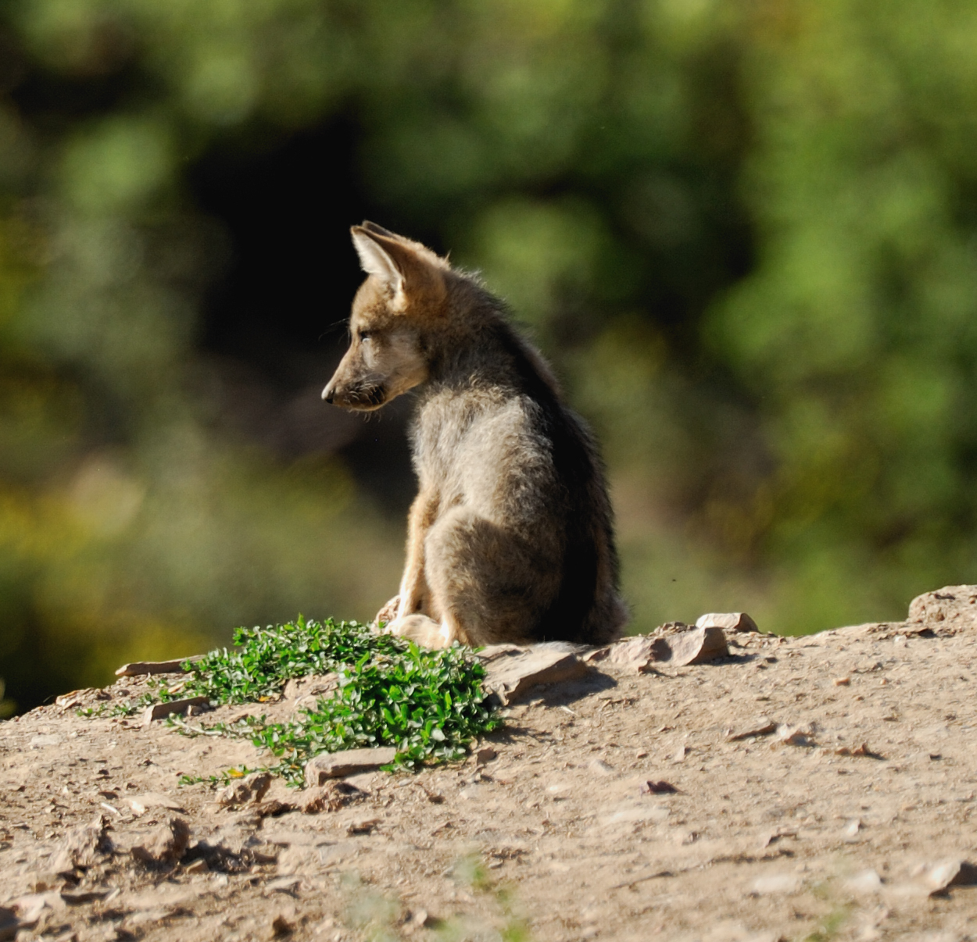
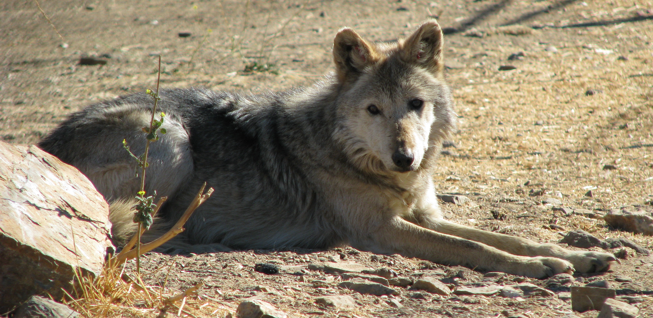
Conservation
HPWREN connectivity has allowed for the growth of the California Wolf Center’s conservation efforts, now on an international scale. Due to our remote location, this would not have been possible without HPWREN technology.
HPWREN equipment has been used to monitor the health of ailing animals, the development of young pups, and changes in wolf pack hierarchy. Such veterinary and behavioral monitoring can go on without disturbing the wolves or influencing their behavior.
HPWREN at the California Wolf Center

Slide 4
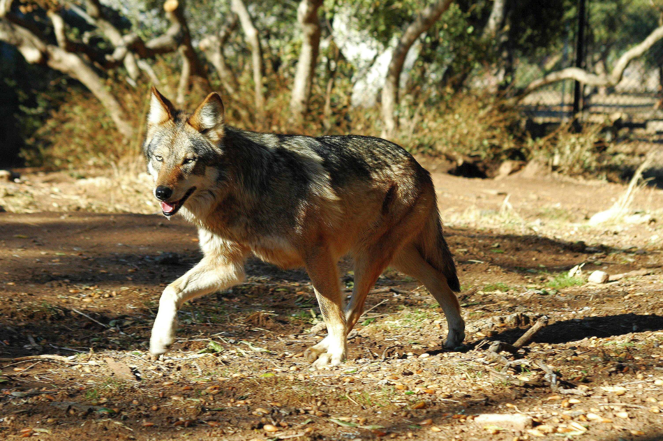

Research
Past projects include vocalization studies, distance learning evaluations, and pack hierarchy studies.
New equipment for 2010 includes a camera which will allow for increased monitoring of both Alaskan and Mexican gray wolves and an acoustic sensor which will offer increased opportunities to record and analyze wolf vocalizations.
The new camera will be the first HPWREN camera to observe Mexican gray wolves, a highly endangered subspecies of gray wolf, offering unprecedented access for researchers and the public.
HPWREN at the California Wolf Center

Slide 5
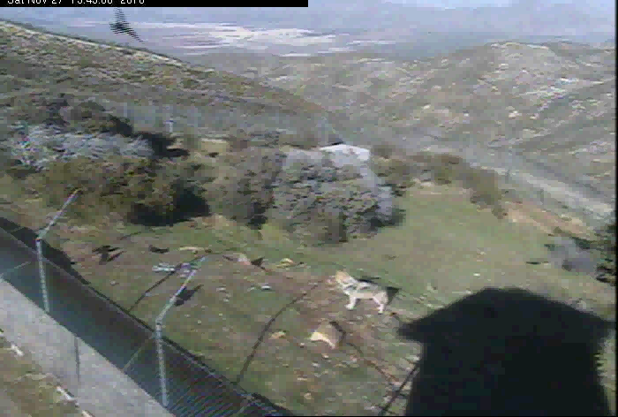
HPWREN PTZ Camera in action!

