Slide 1



Two Recent Examples of NEES@UCSB using HPWREN for Outreach
Jamison Steidl
UC Santa Barbara
2010 HPWREN Annual Meeting
http://nees.ucsb.edu

Slide 2
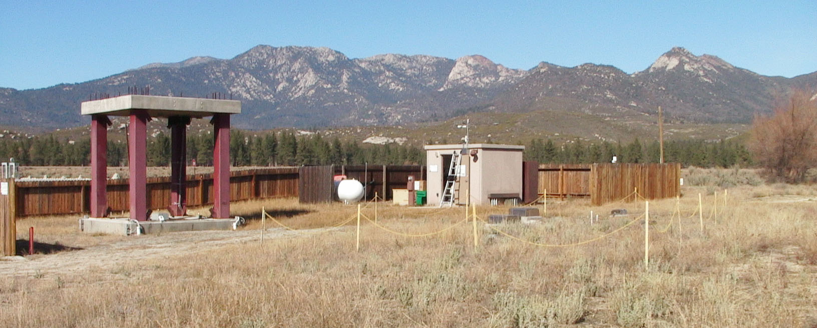
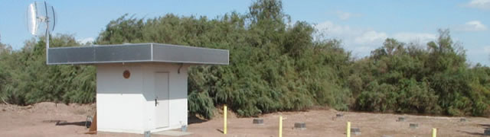
NEES@UCSB
GVDA (top) and WLA (bottom) Field Sites
Notes:
What are the NEES@UCSB Field sites?
Permanently instrumented field sites for monitoring ground motion, liquefaction, and soil-foundation-structure interaction
Southern California along active fault zones, GVDA above Palm Springs along the San Jacinto Fault, WLA below the Salton Sea along the San Andreas Fault

Slide 3
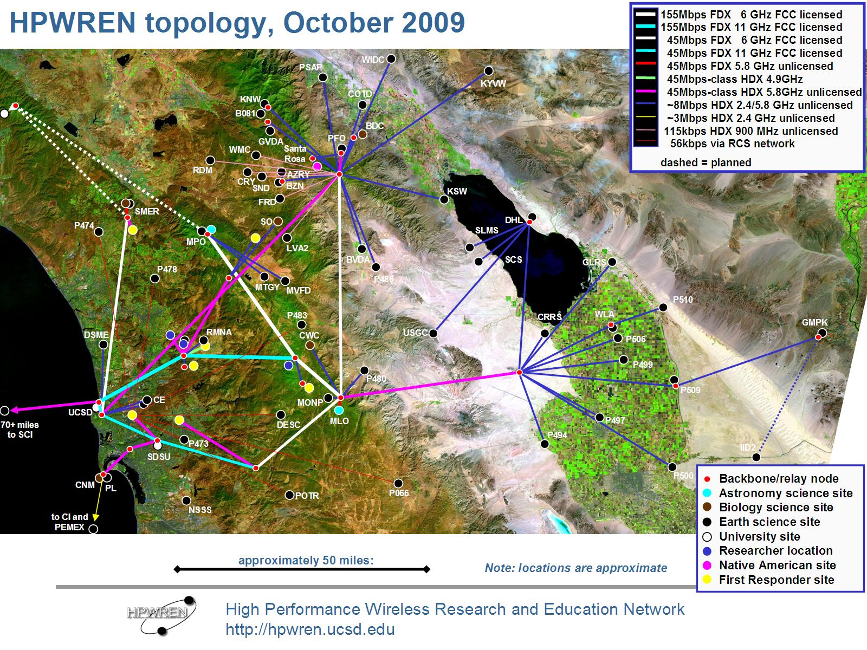
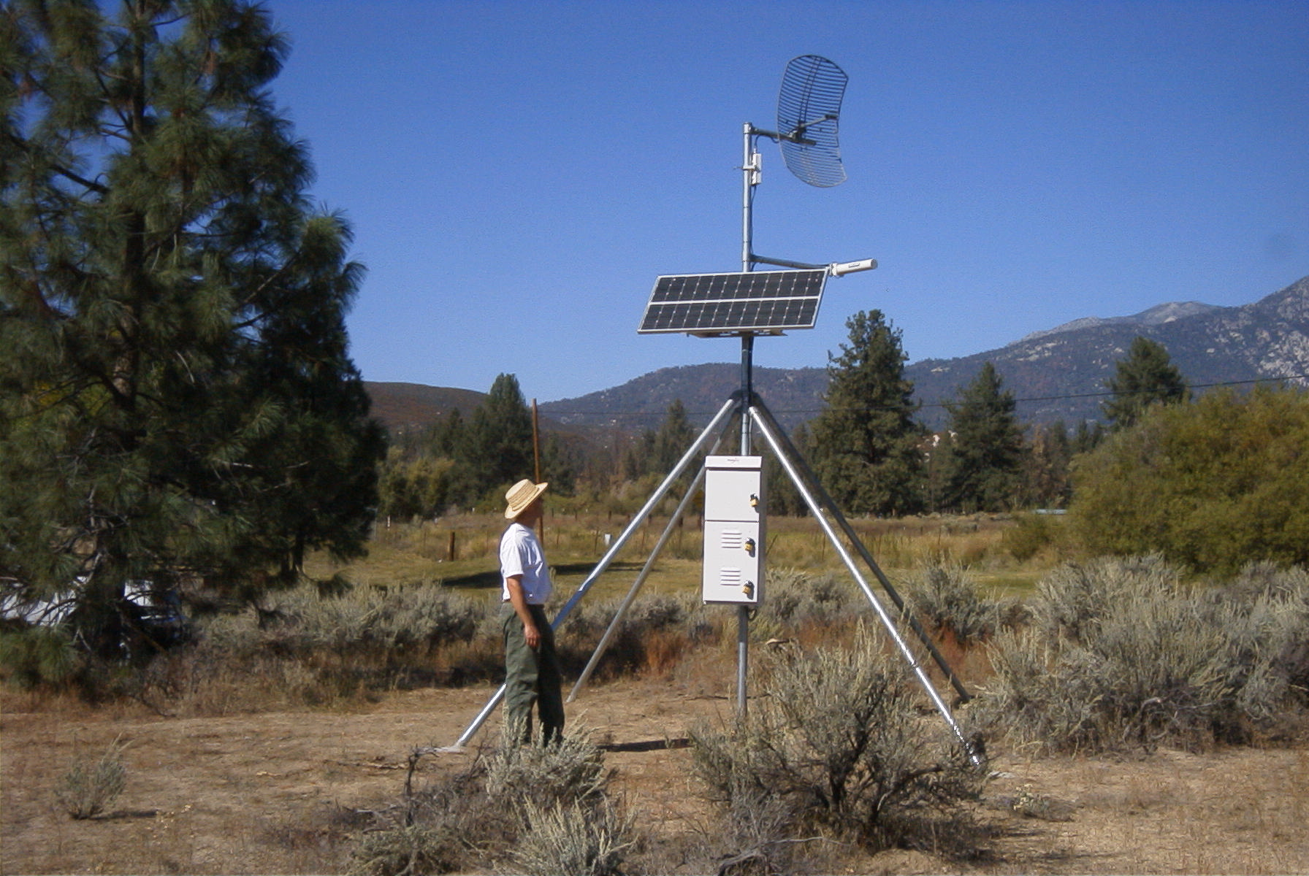
Wireless Video & Data Telemetry
via
UCSD’s HPWREN
Notes:
HPWREN connectivity is a critical part of the NEES@UCSB operations.

Slide 4
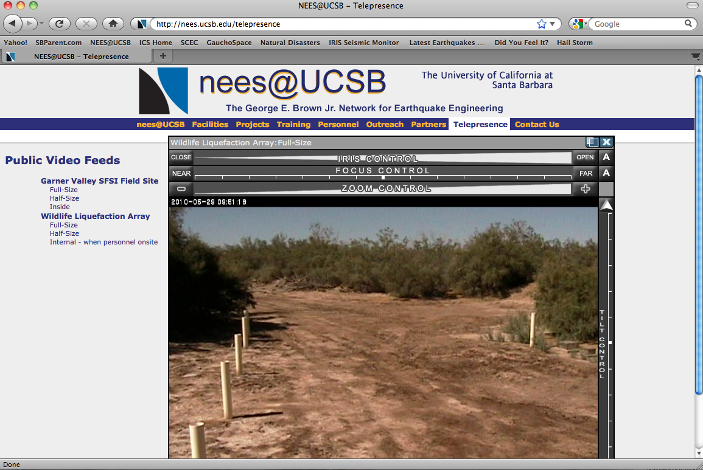
Using HPWREN to take Researchers on a Virtual Tour of the Field sites
http://nees.ucsb.edu/telepresence
Notes:
A post conference field trip highlighting the NEES program at UC San Diego and the mobile and permanent field facilities at UCLA, UTA, and UC Santa Barbara.
~85 participants were given a virtual tour of the UCSB field sites using the HPWREN provided telepresence. In addition to touring the field site facilities, current research projects, significant earthquakes, access to data, and future research potential were discussed.

Slide 5
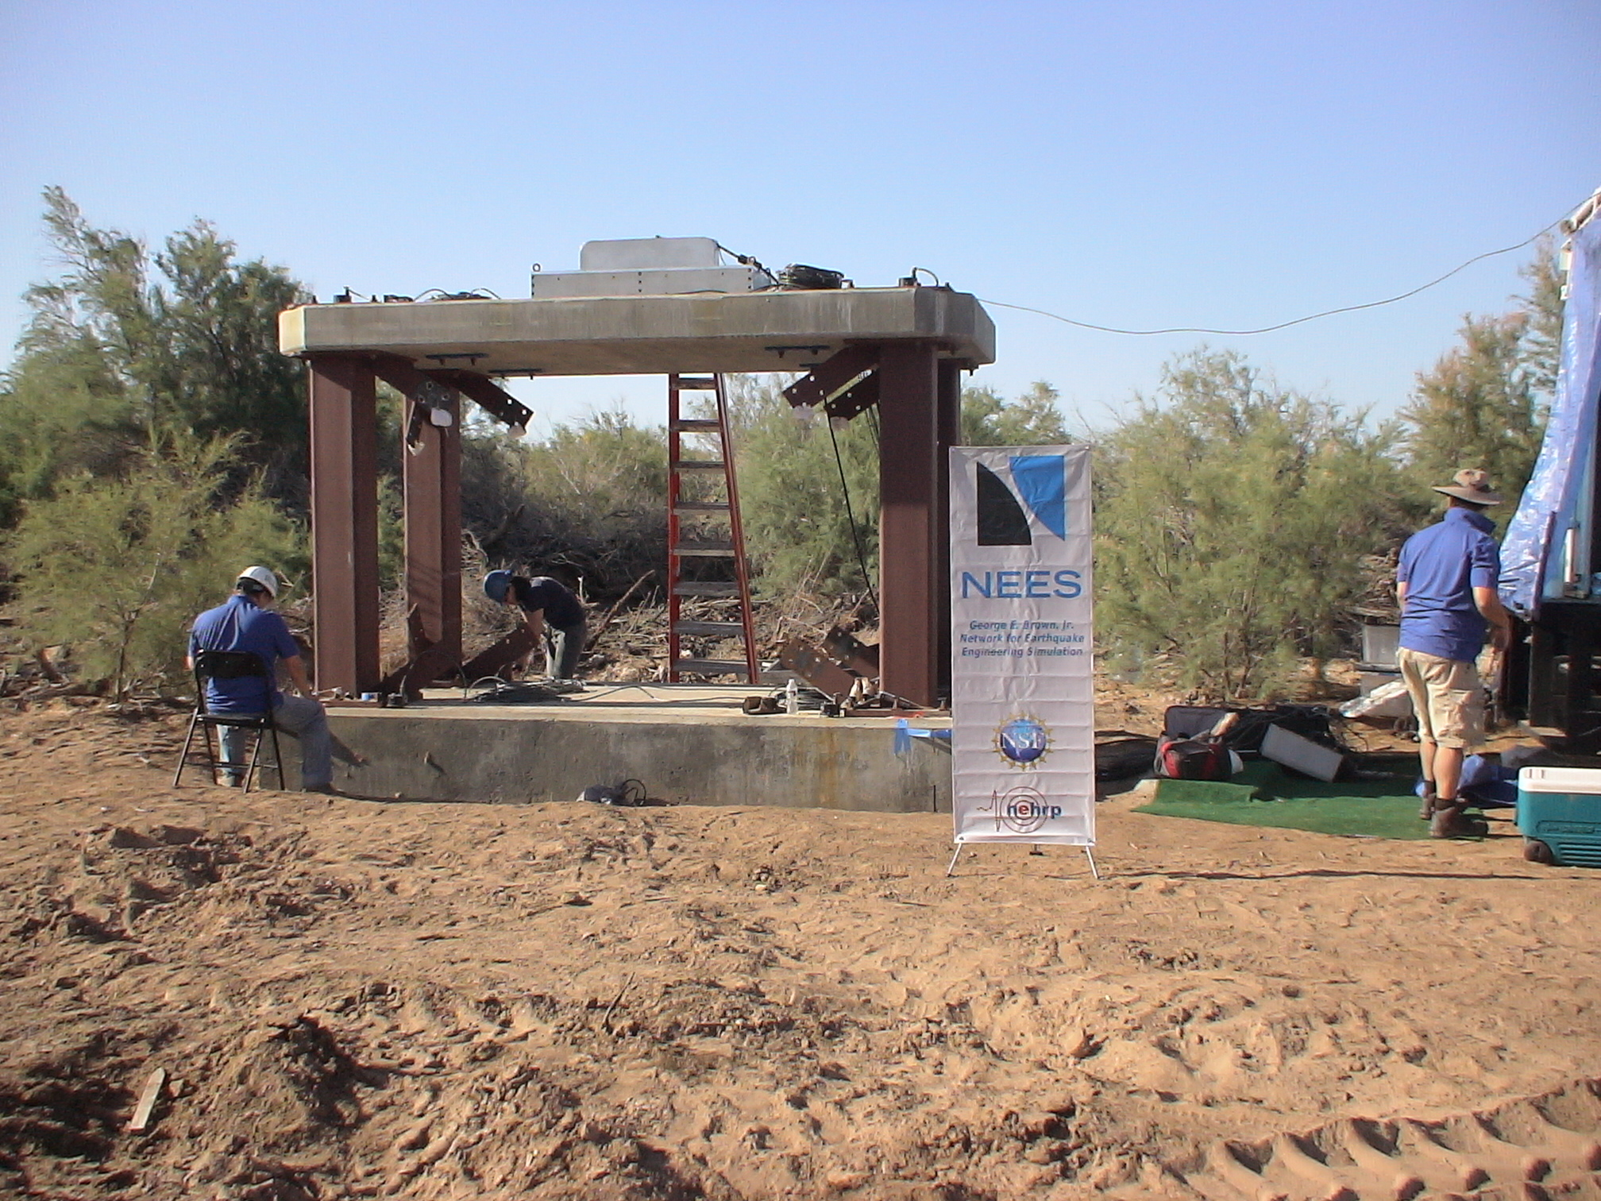
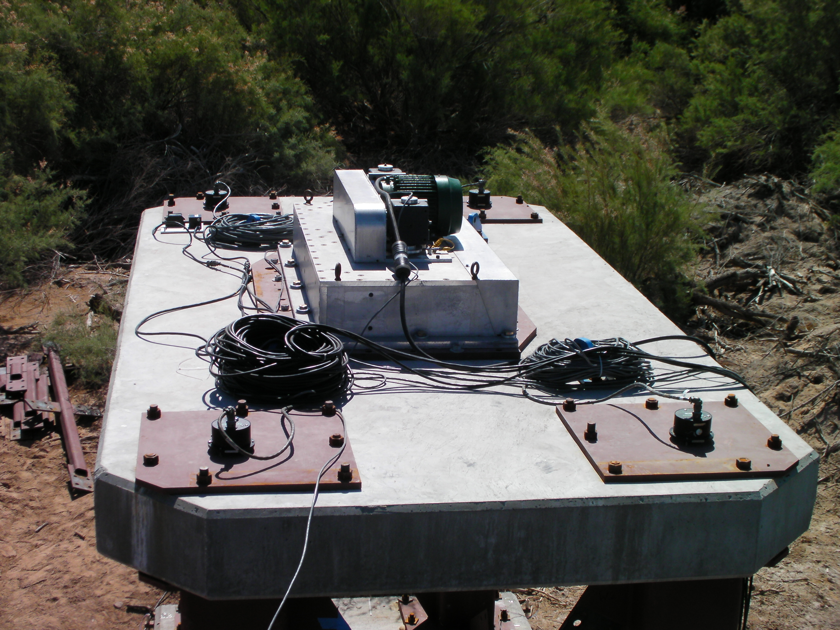
Webcasting Experiments
UC Berkeley NEESR Grand Challenge
NEES@UCLA and project co-PI Stewart testing at WLA
2010 Project- NEES@UCLA’s “Mighty Mouse” shakes the temporary structure at WLA
Notes:
During a 2010 research experiment, an additional camera was installed while a temporary structure was being excited using the Mighty Mouse shaker from the NEES@UCLA equipment site. The experiment was viewed by a number of researchers nationwide as well as program managers at NSF in Washington DC.

Slide 6


Please visit us at . . .
http://nees.ucsb.edu/
Special Thanks to:
The nees@UCSB Team:
Sandy Seale
Hank Ratzesberger
Paul Hegarty
Francesco Civlilini
Sarah Askeland
Robin Gee
The George E. Brown, Jr. Network for Earthquake Engineering Simulation (NEES) Program of the National Science Foundation
Award Numbers CMS-0217421, CMS-04002490, and CMMI-0927178
Remote site communications are made possible by the HPWREN program at UC San Diego, NSF grant numbers 0087344 and 0426879 and 0944131

